Slide 1
Covid Applications and QR Codes

Slide 2
Presenters
Elliot
Excellium - AppSec
Alexis
Valentin

Slide 3
Agenda
COVID applications and QR codes
1. Applications overview
2. COVID Certificates QR Codes
3. Contact tracing Apps
4. Takeaways and Q&A

Slide 4
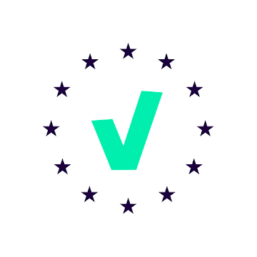
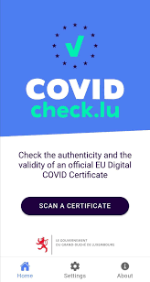
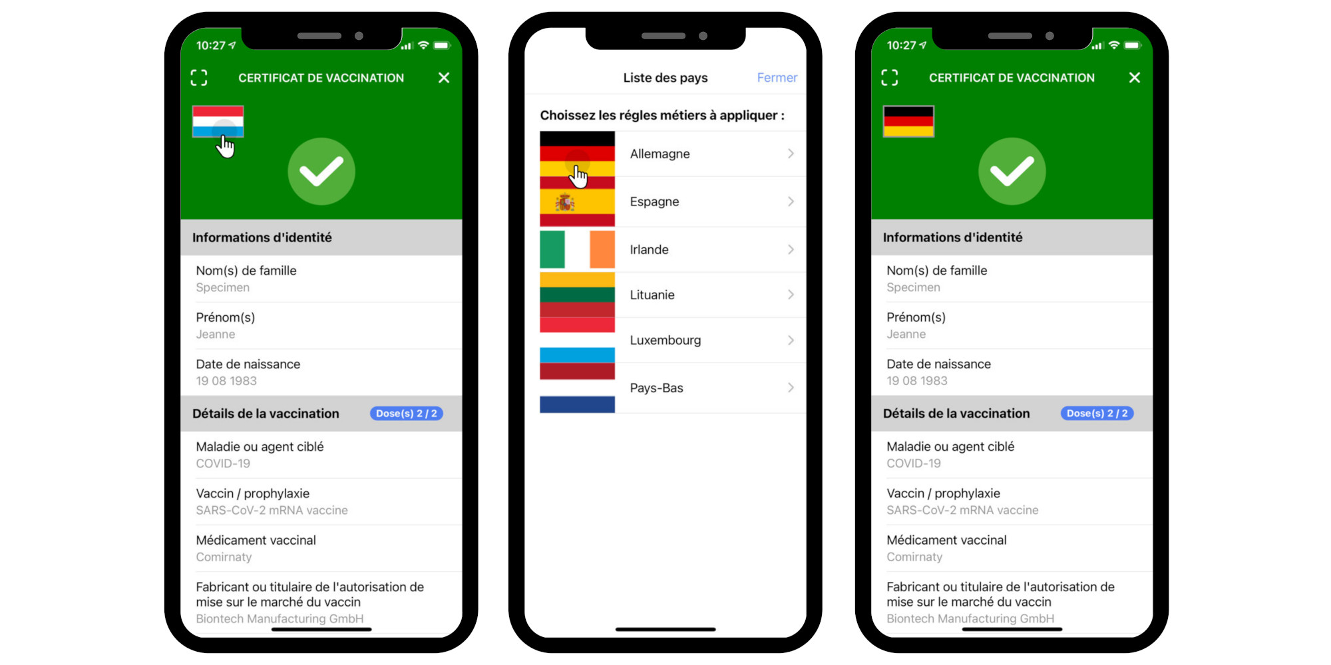
Luxembourg
1. Single application

Slide 5
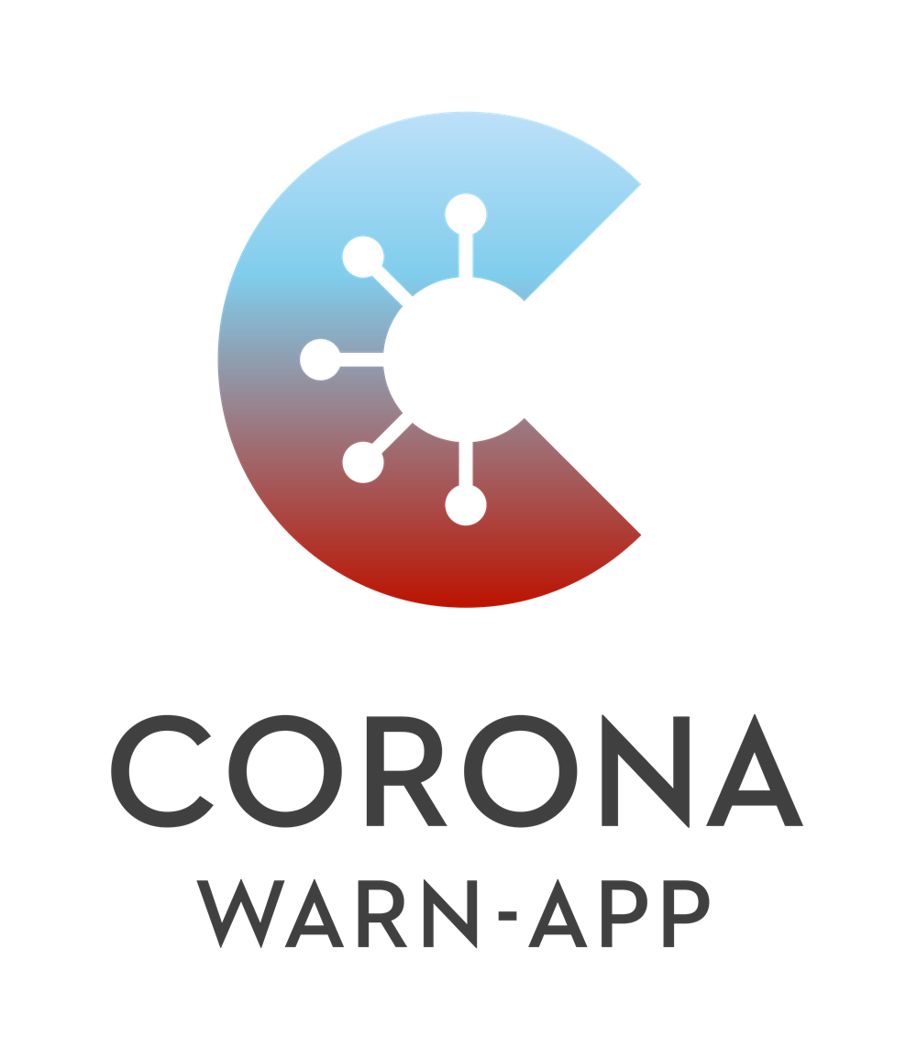
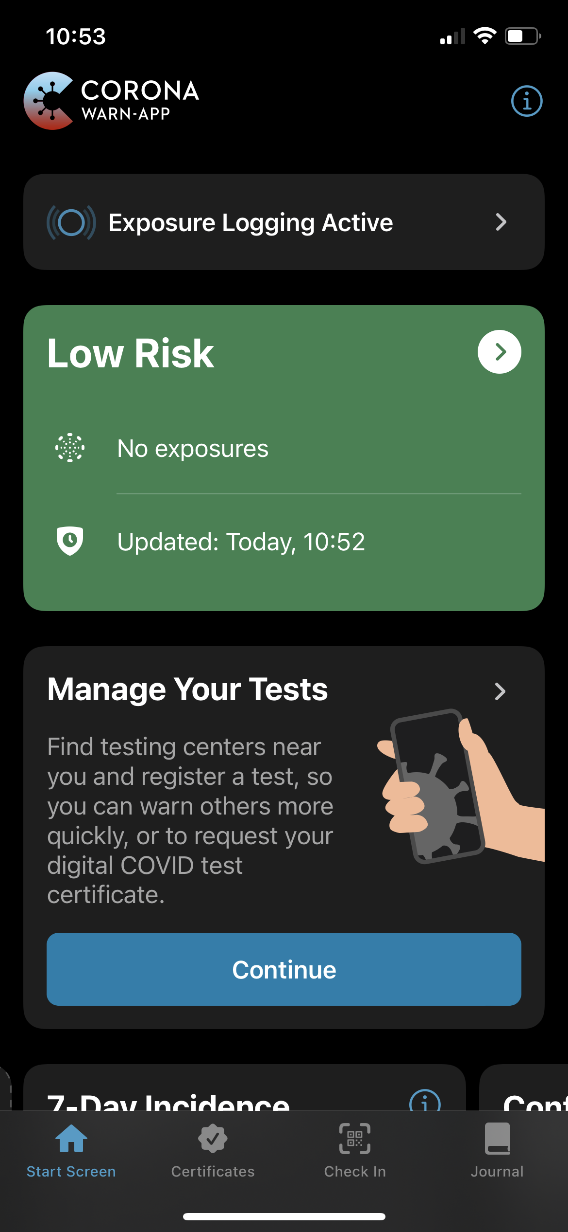
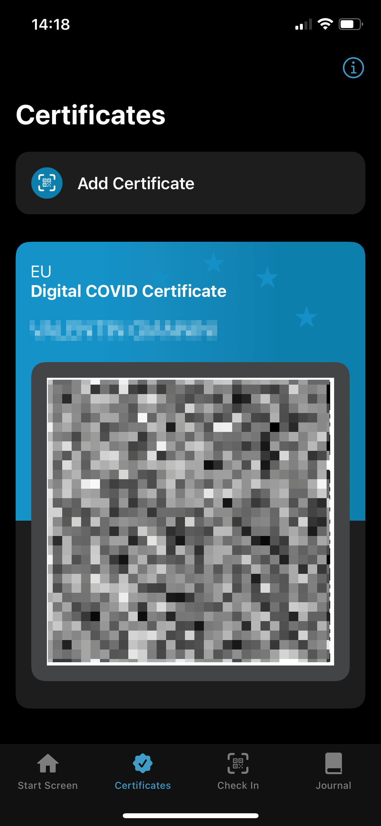
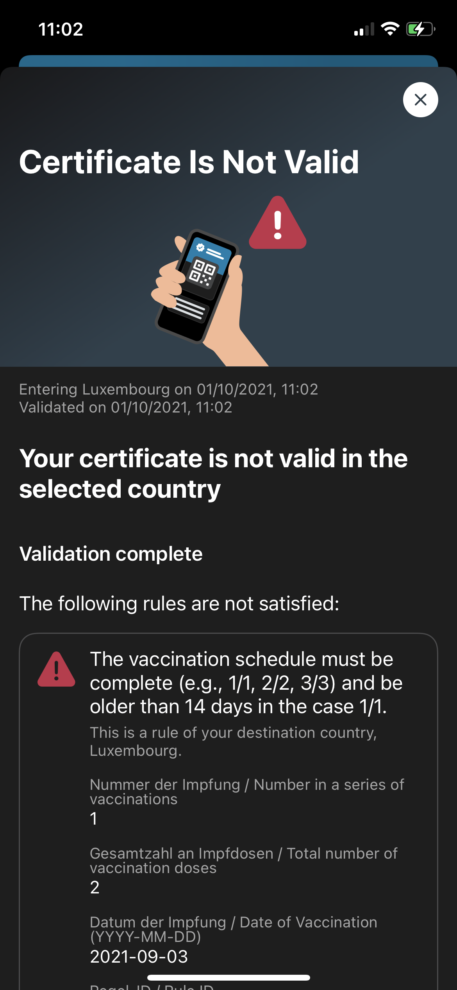
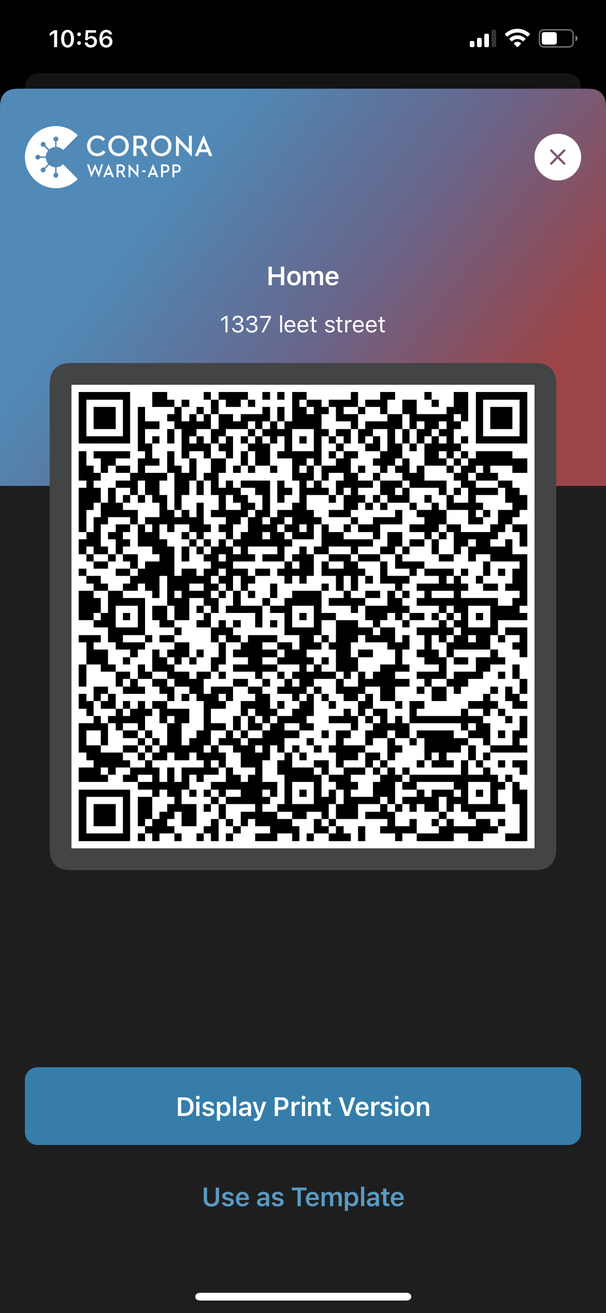
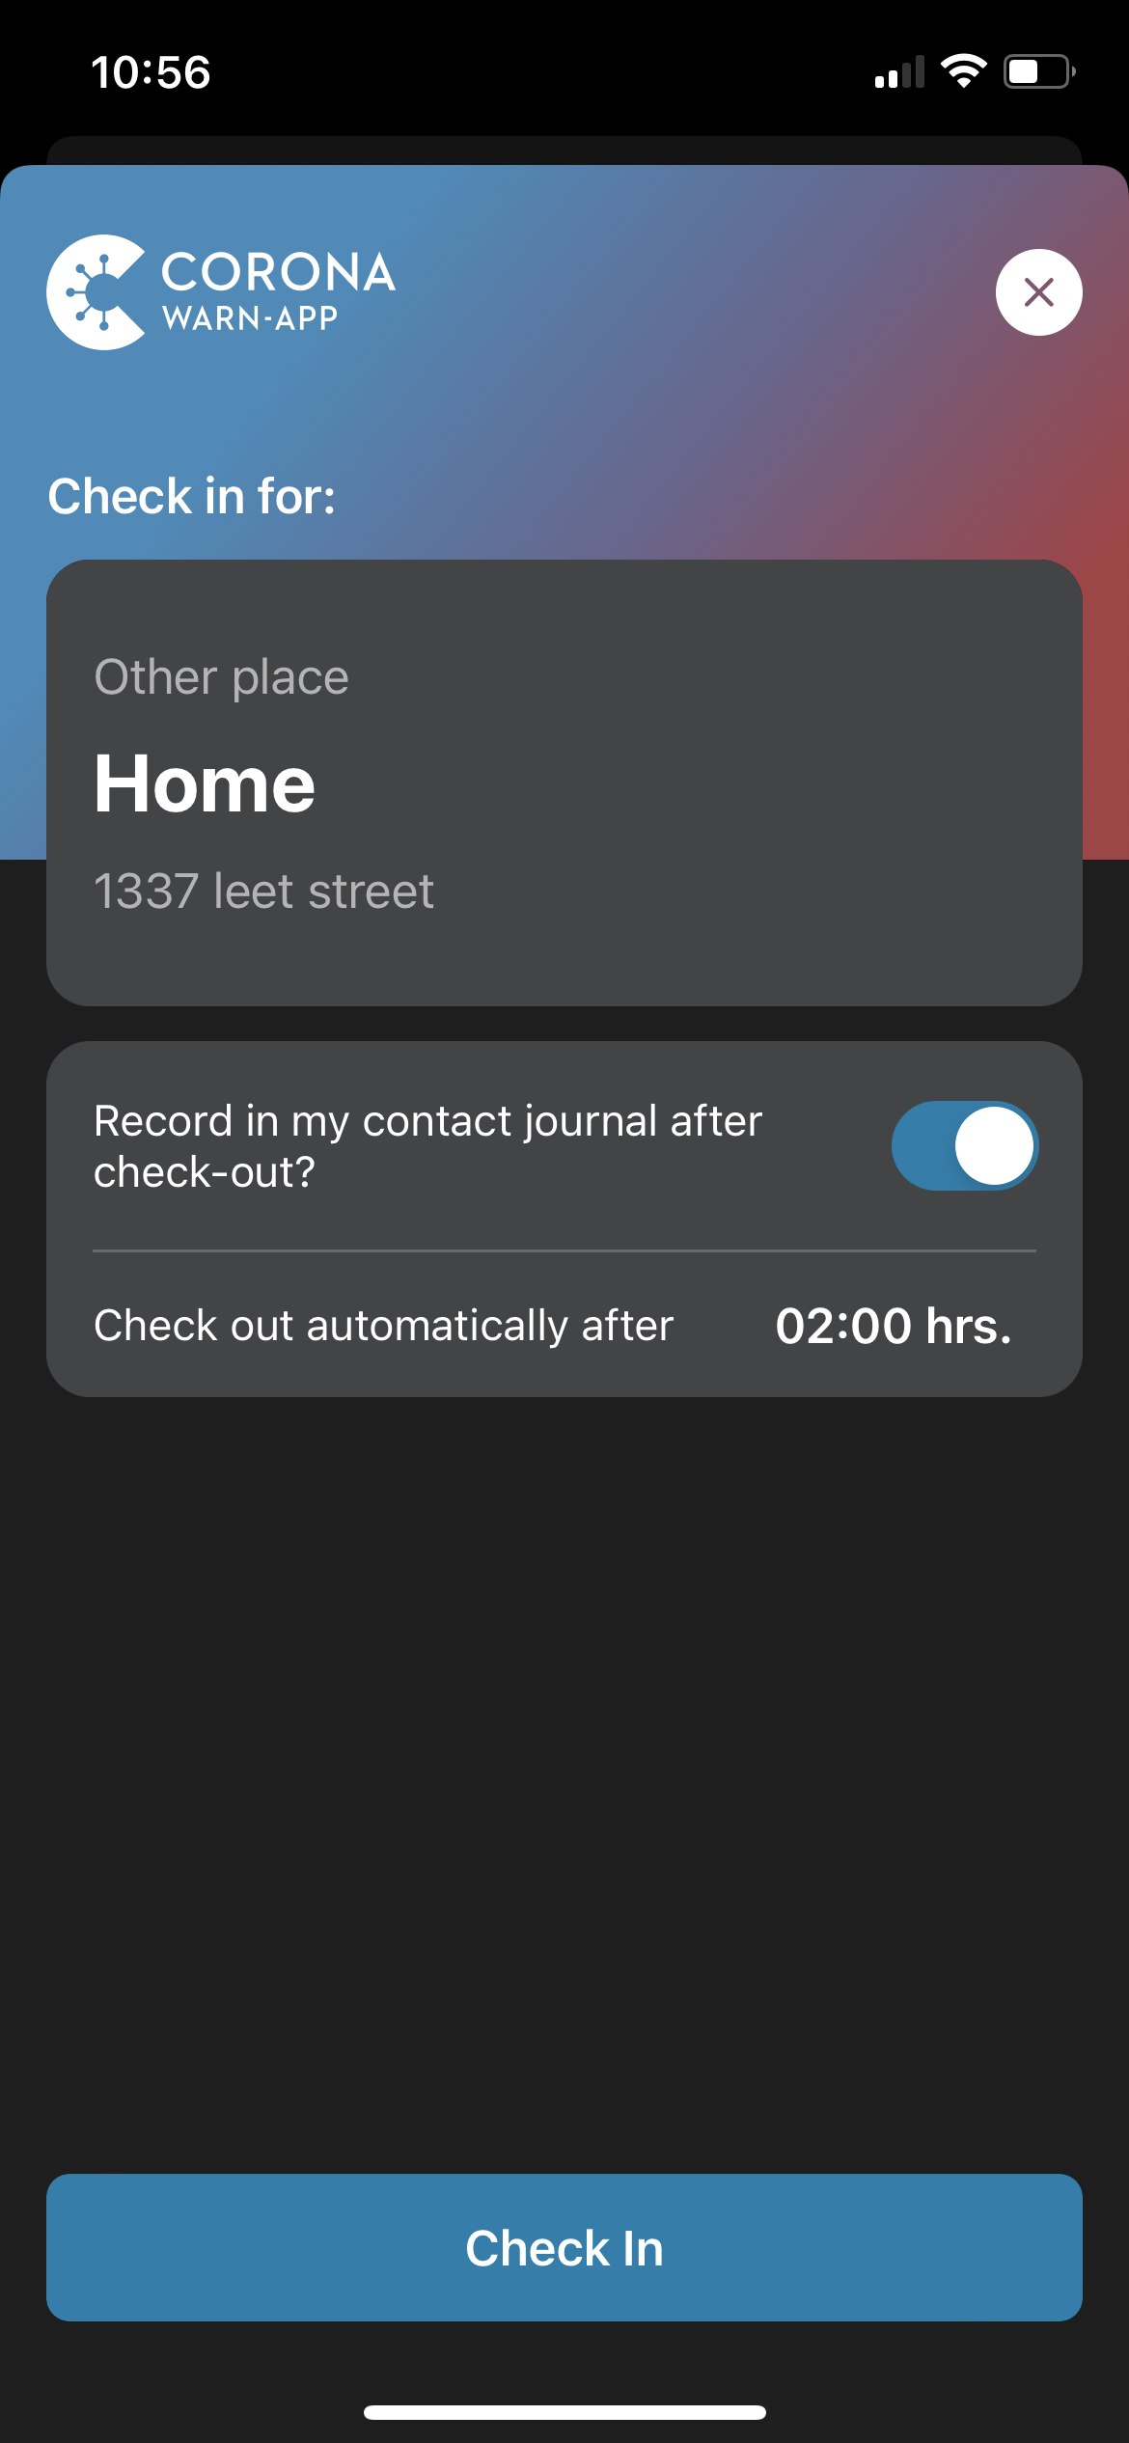
Germany
Notes:
Contact tracing
Info, stats, …
QrCode management
Check your own certificate for DE + other country
Private event creation

Slide 6
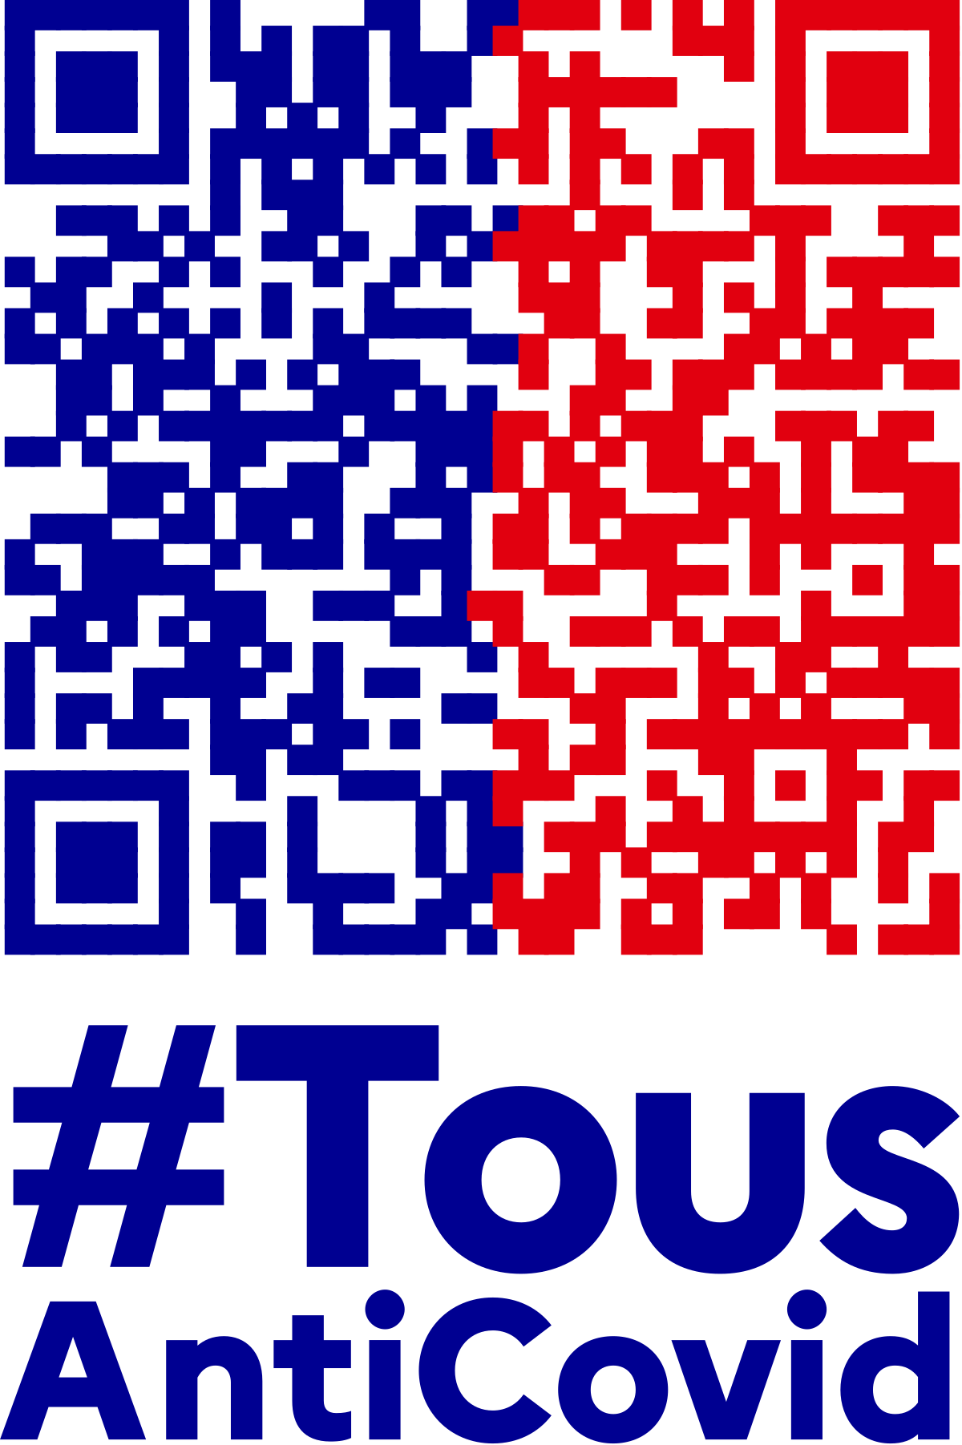
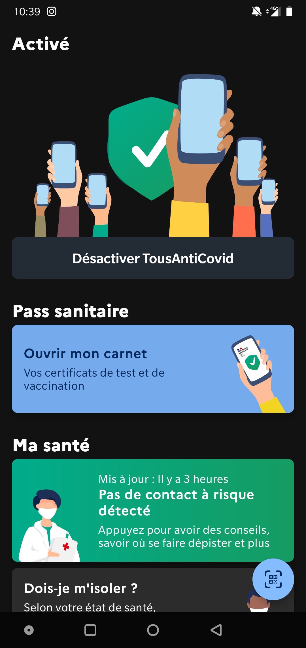
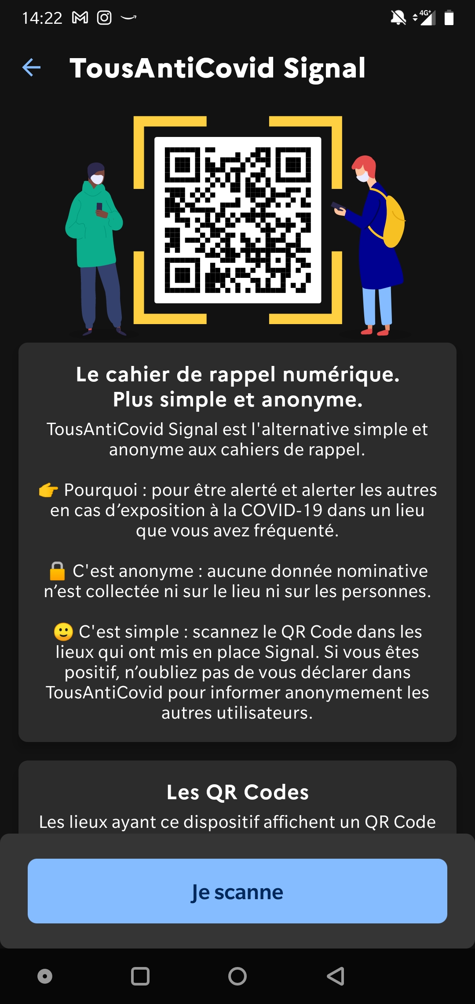
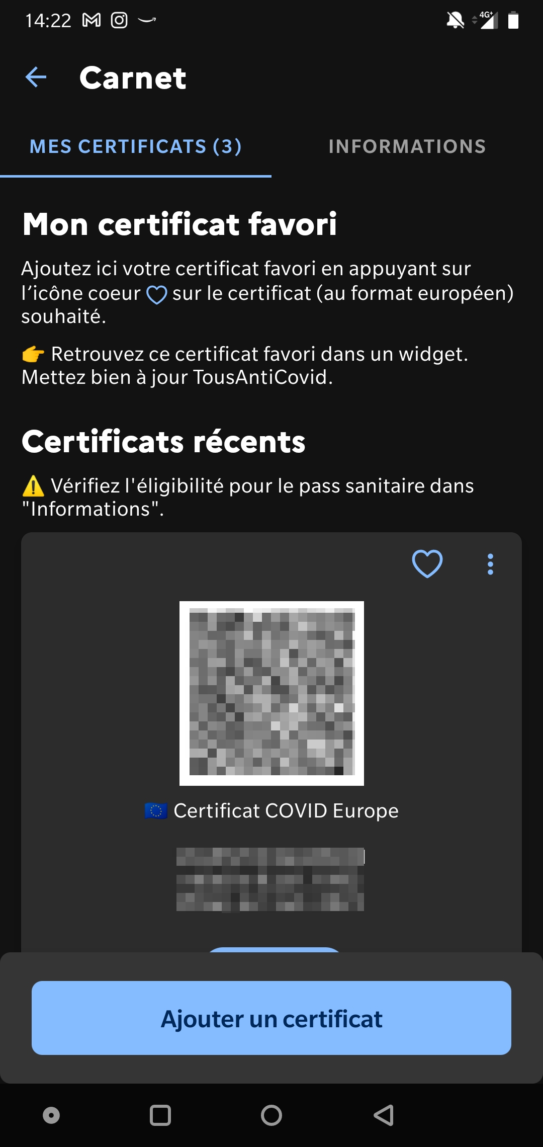
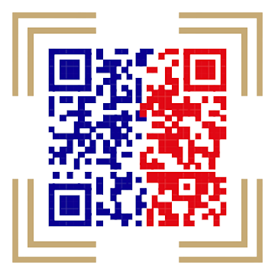
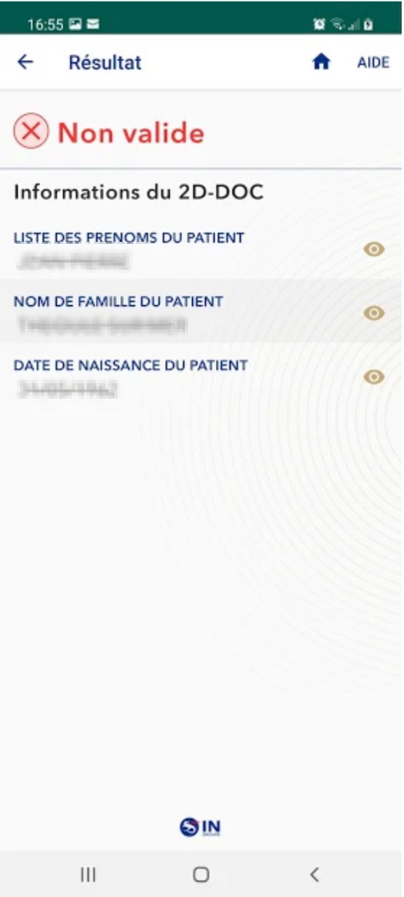
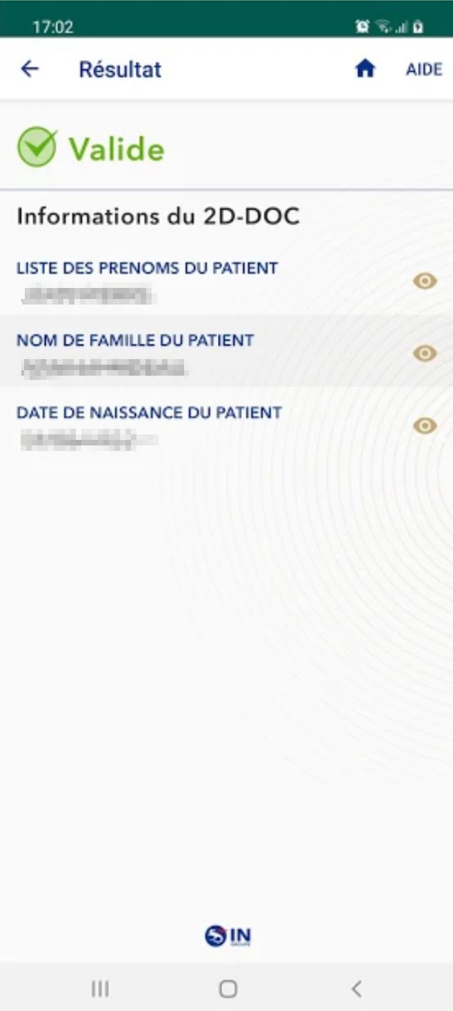
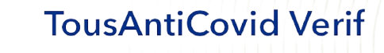
France
2 Different applications
Notes:
TAC
Contact tracing
Info, stats, …
QrCode managament
Private event
TAC Verif
Check any QrCode for France

Slide 7
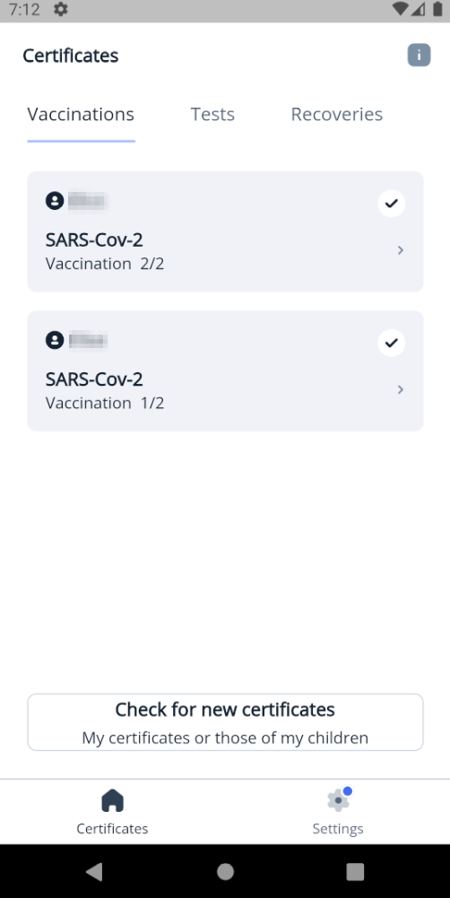
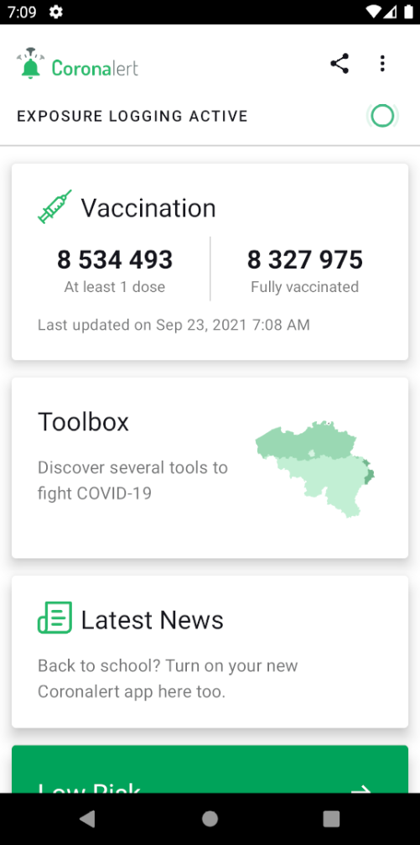
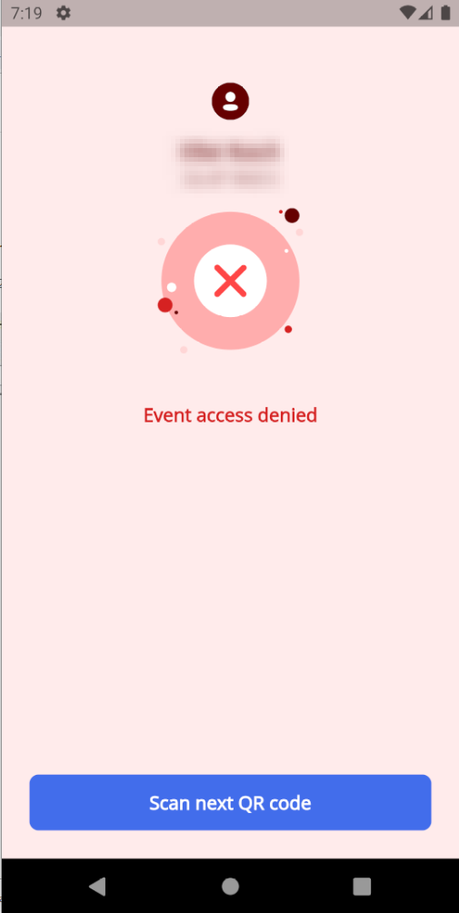
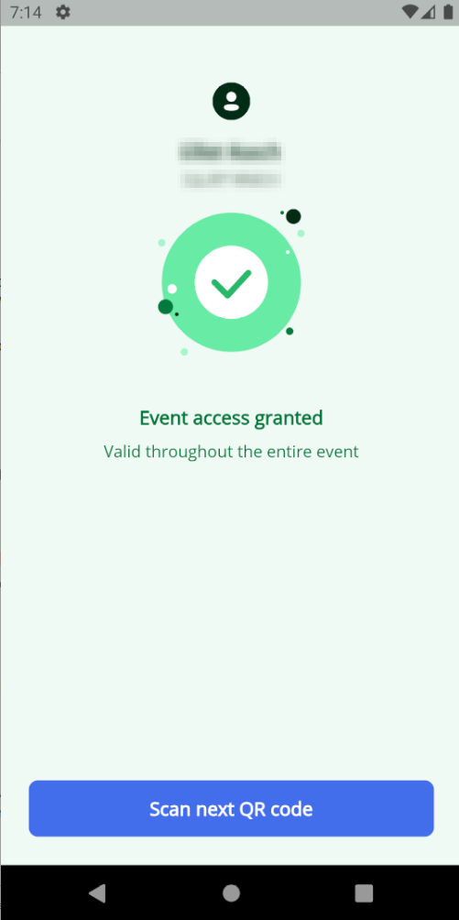
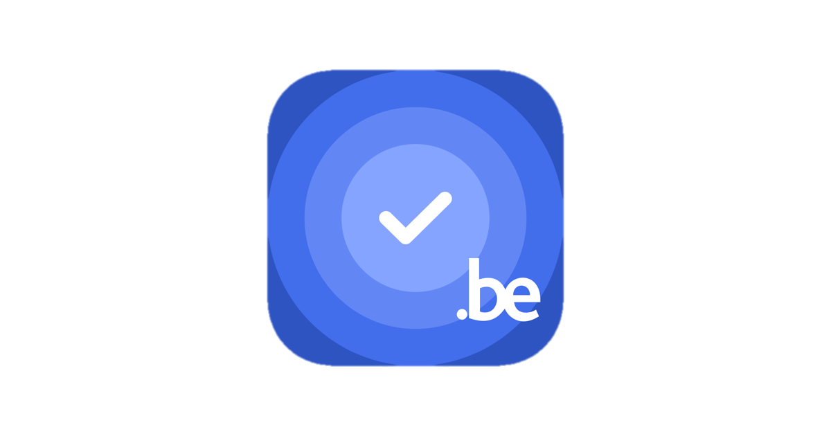
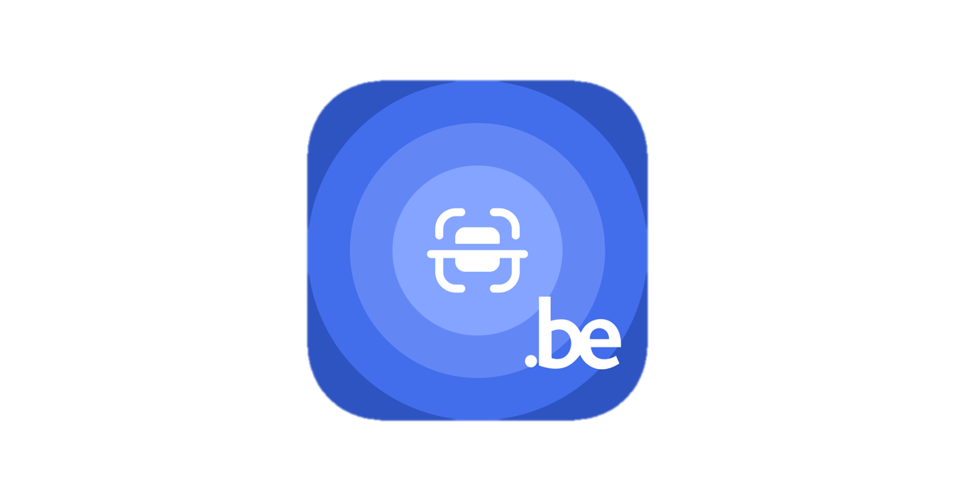
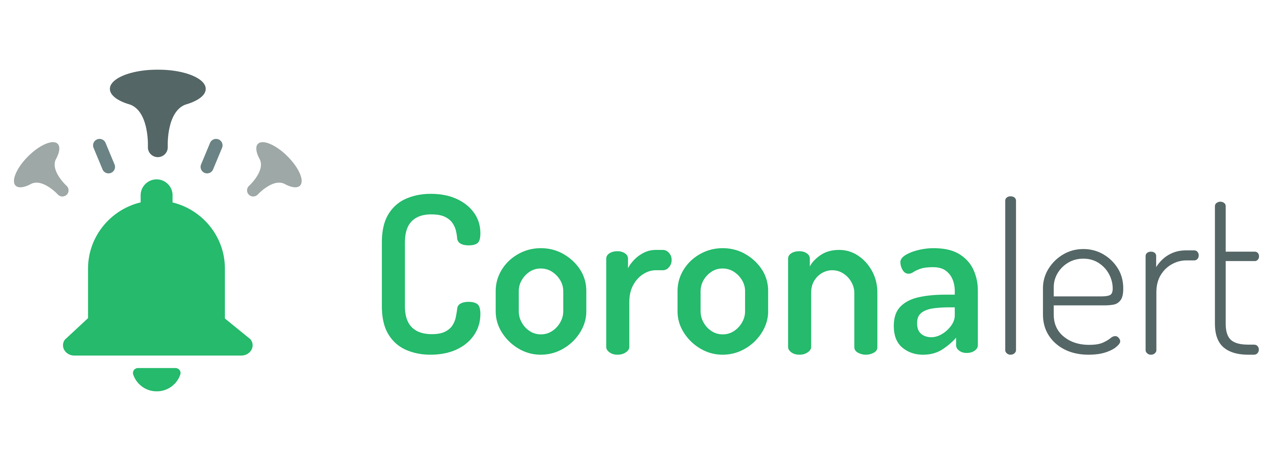
Belgium
3 Different applications
CovidSafe
CovidScan
Notes:
Covid safe
QrCode
Covid Scan
Check QrCode for BE
Coronalert
Contact tracing
Infos, stats, …

Slide 8
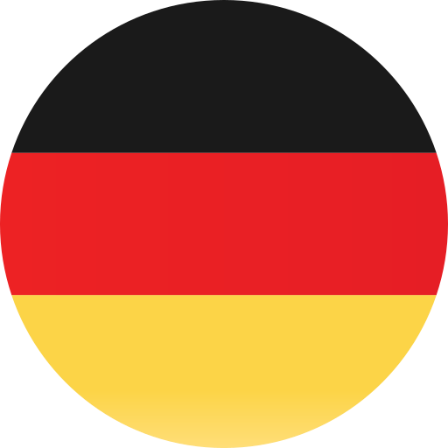
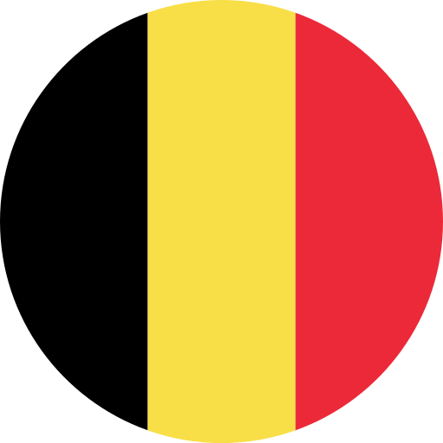
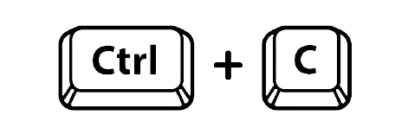
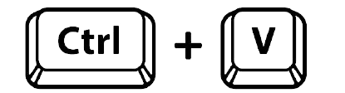
Coronalert
Contact tracing app
Developed originally by SAP (DE)
Overseen by cyber security experts from German research institutes.
Made open source
Fork (copy) of the German app
Without the covid certificate feature
(included in separate app for Belgium)
Notes:
# Coronalert
The belgian Coronalert application is a copy of the german application Corona Warn App (CWA).
Developped originally by SAP (DE) and overseen by cyber security experts from german research institutes.
The App sends a push message to users if they have been exposed to a person diagnosed with COVID-19 (at least 15 minutes within the last 14 days).
⚠ Some laboratories and public health offices aren't equipped with the digital infrastructure to send test results to the system.
People who have been tested by such laboratories won't be reported in Coronalert.
Method:
Pseudonymized data and Bluetooth technology.
- NO GEOLOCATION
- NO CONTACT ACCESS
- No personal information is transmitted: When you encounter another person using the app, your smartphones only exchange random IDs. They measure the time and distance of an encounter, but do not allow to identify persons or find out locations.

Slide 9
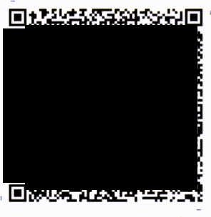
CovidSafeBE
Covid Certificate app
Founded by the Belgian government
Login via itsme or eHealth platform
Use EU digital certificates (DCC)
Transfer analytics data to Firebase (Google)
Anti fake / forgeries with “moving frame”.
The goal is to prevent screenshot and QR code sharing

Slide 10




1. Applications comparatives
What can it do?
 |  | Obtain Covid Certificate | Check Covid Certificate | Covid case alert
BE | Coronalert | ❌ | ❌ | ✔
 | CovidSafeBE | ✔ | ❌ | ❌
 | CovidScanBE | ❌ | ✔ | ❌
FR | TousAntiCovid | ✔ | ❌ | ✔
 | TousAntiCovid Verif | ❌ | ✔ | ❌
LU | CovidCheck.lu | ❌ | ✔ | ❌
DE | Corona Warn App | ✔ | ❌ | ✔
 | CovPass | ✔ | ❌ | ❌
 | CovPassCheck | ❌ | ✔ | ❌

Slide 11
1. Comparison
Permissions
 |  | GPS | Bluetooth | Contact | Camera | Microphone | Storage Access
BE | Coronalert | No | Yes | No | No | No | No
 | CovidSafe |  | No | No | No | No | No
 | CovidScan |  |  |  | Yes | No | No
FR | TousAntiCovid | No | Yes | No | Yes | No | No
LU | CovidCheck.lu | No | No | No | Yes | No | No
DE | Corona Warn App | No | Yes | No | Yes | No | No
 | Facebook | Yes | Yes | Yes | Yes | Yes | Yes

Slide 12
1. Comparison
Design
 |  | SSL Pinning | Framework | Back-end | Open Source
BE | Coronalert | ✔ | Android stack | Spring boot PostgreSQL | ✔
 | CovidSafe | ✔ | Flutter | N.A | ❌
 | CovidScan
FR | TousAntiCovid | ✔ | Android stack | Spring boot PostgreSQL | ✔
LU | CovidCheck.lu | ✔ | Cordova JS | Spring boot | ❌
DE | Corona Warn App | ✔ | Android stack | Spring boot PostgreSQL | ✔
Notes:
SSL pinning:
Le certificat SSL crée une base de confiance en établissant une connexion sécurisée.
Cela permet entre autre de vérifier l’intégrité des données et d’empêcher leur interception
Android stack = pas de framework. Juste SDK android
Flutter = kit development google
Cordova = Apache

Slide 13
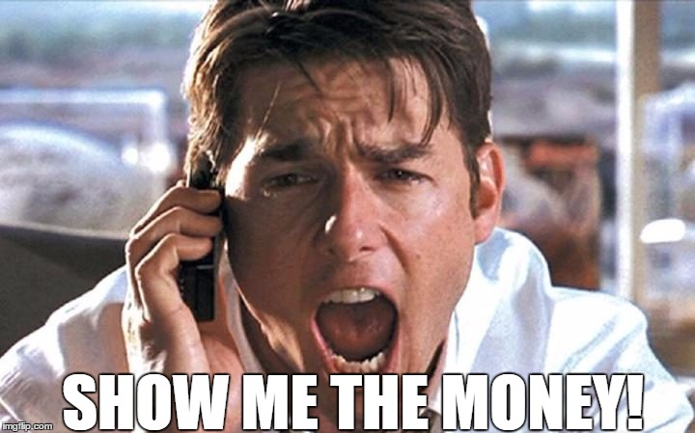


1. Comparison
Development budget comparison
Budget for contact tracing apps only
41 M
20 M
9 M
3.29 M
1 M
None
Notes:
Source:
https://www.bfmtv.com/tech/developpement-publicite-l-appli-tous-anti-covid-a-coute-7-millions-d-euros_AN-202104080390.html
CWA
https://joinup.ec.europa.eu/collection/open-source-observatory-osor/news/belgium-forked-its-covid-19-app
https://www.digitalhealth.net/2020/09/total-cost-of-nhs-contact-tracing-app-set-to-top-35-million/
https://fr.wikipedia.org/wiki/TousAntiCovid
https://fr.wikipedia.org/wiki/SwissCovid#Costs

Slide 14
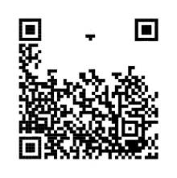
2. COVID CERTIFICATES
QR CODES
What data is stored ?
Encrypted data? Binaries ? Text ?
Personal information ? How sensitive ?
Is it the same in …
In all countries of EU?
In the world ?
Can you steal someone’s QR code ? What can you do with it?
Crafting/Editing QR Code?

Slide 15
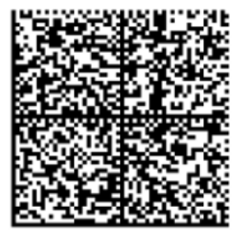
When the French did it differently
2D-DOC
First COVID vaccine injection
June 23 2021
2D-Doc
1: https://ants.gouv.fr/content/download/516/5665/version/9/file/ANTS_2D-Doc_CABSpec_v3.1.1.pdf
2: https://www.numerama.com/sciences/726127-certificat-de-vaccination-europeen-tout-comprendre-au-qr-code-sur-votre-document.html
Notes:
At the start of the COVID pass, France used a format for the COVID pass called 2D Doc which is a derived from a Data Matrix. This format is like a QR code with an error recovery feature and a different reading method.
In this, a lot information were planned to be contained as shown in the specification(1).
In the end, few information are contained in the 2D Doc that the citizens received.

Slide 16
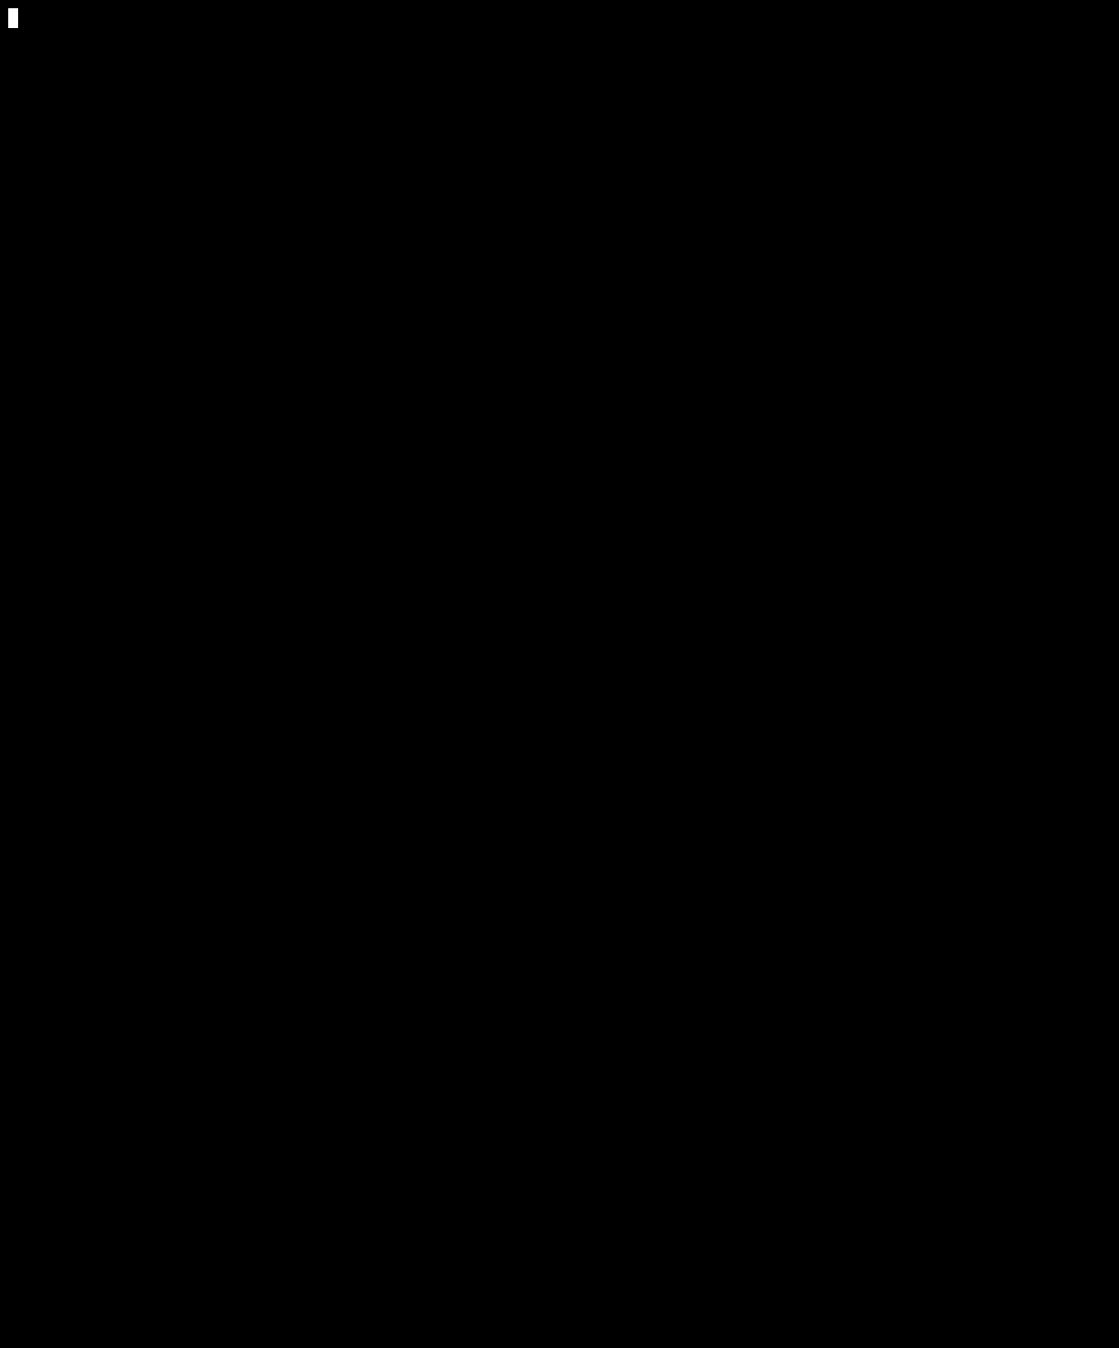
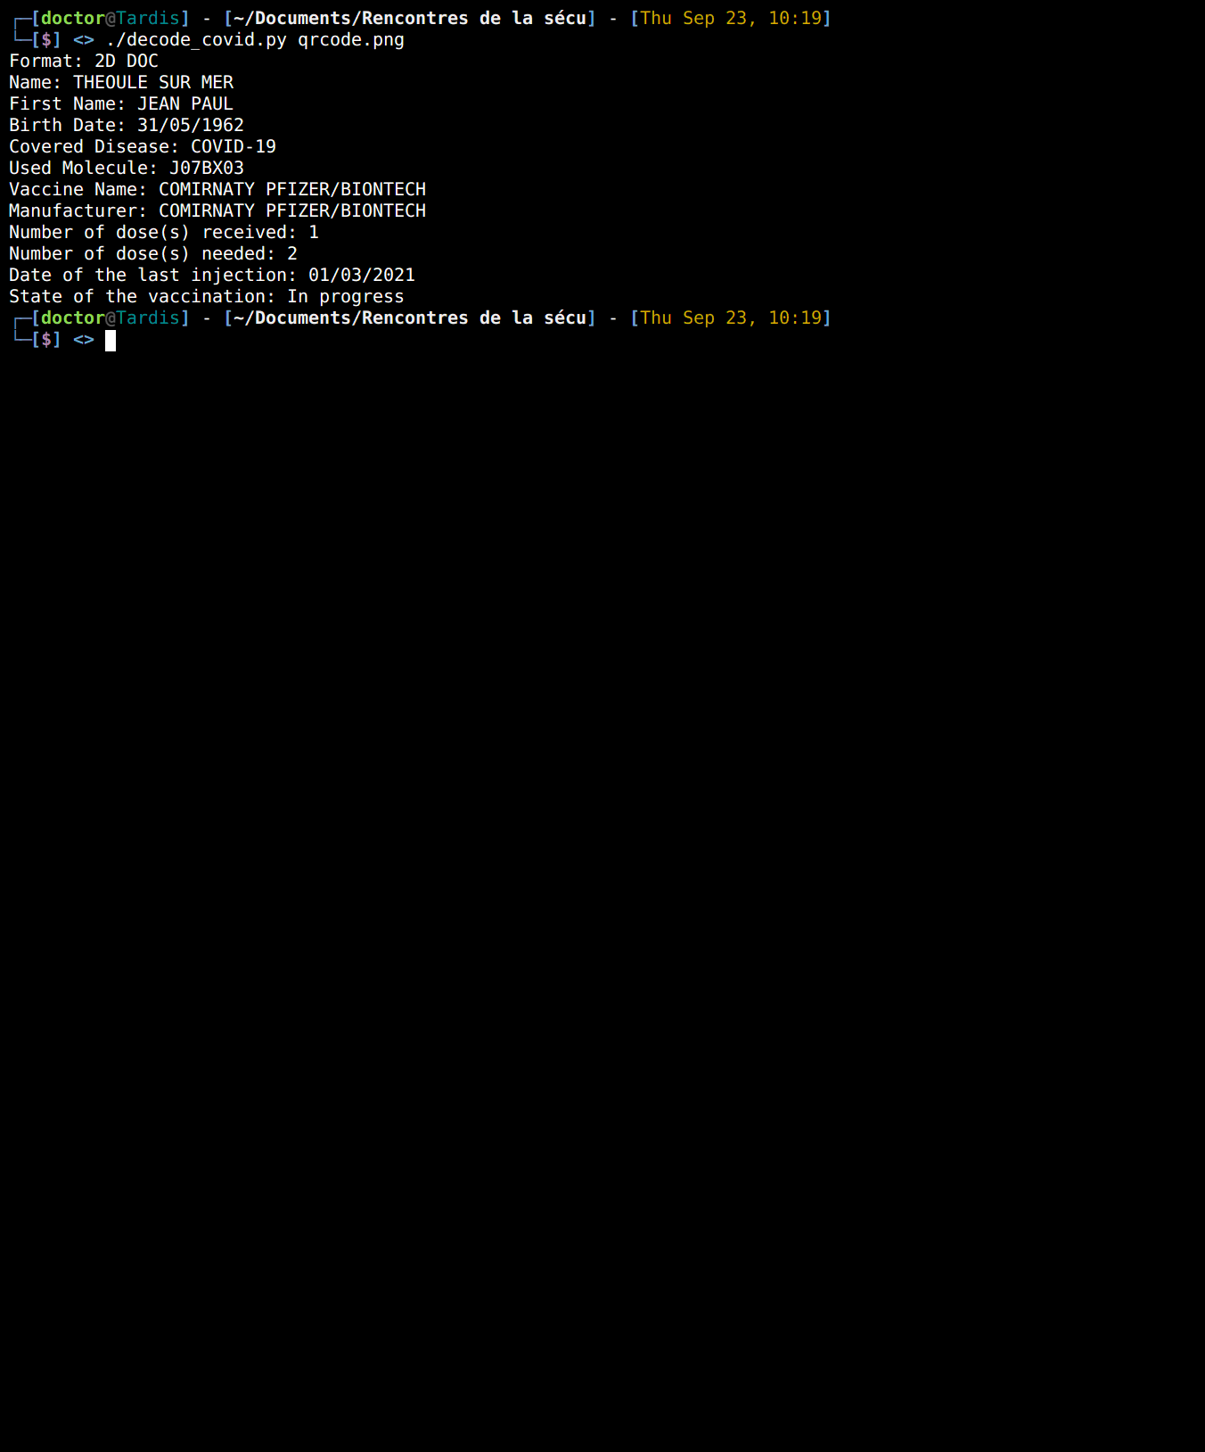
But what does it contain?
2D-Doc
Notes:
At the start of the COVID pass, France used a format for the COVID pass called 2D Doc which is a derived from a Data Matrix. This format is like a QR code with an error recovery feature and a different reading method.
In this, a lot information were planned to be contained as shown in the specification(1).
In the end, few information are contained in the 2D Doc that the citizens received.

Slide 17
But what does it contain?
Personal data | Medical data
Name | Name of the vaccine
First Name | Number of doses received
Date of birth | Number of doses needed
 | Date of the last injection
2D-Doc
Notes:
This data is available in cleartext in the data matrix once translated in chain of characters. A sequence of characters starting by the ‘\x1D’ character (Group separator) delimit the different fields in the string.

Slide 18
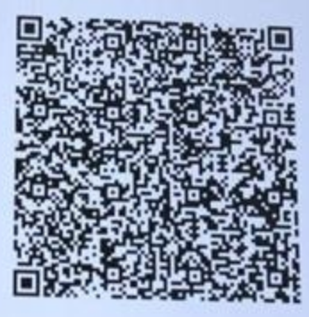
The uniformization in the European Union
DCC
June 23 2021 (FR)
Now
DCC QR code
1: https://ec.europa.eu/health/sites/default/files/ehealth/docs/covid-certificate_json_specification_en.pdf
Notes:
The accord for the EU certificate is dated from the may 2021 The 23rd of June 2021, Covid Certificates were uniformized between countries inside the EU. All the counties adopted the Digital Covid Certificate (DCC) based on the QR code technology.
A lot less information are made to be stored in it as described in the specifications(1).
This new certificate was made for three purposes:
- Vaccine
- Tests (PCR)
- Recoveries

Slide 19
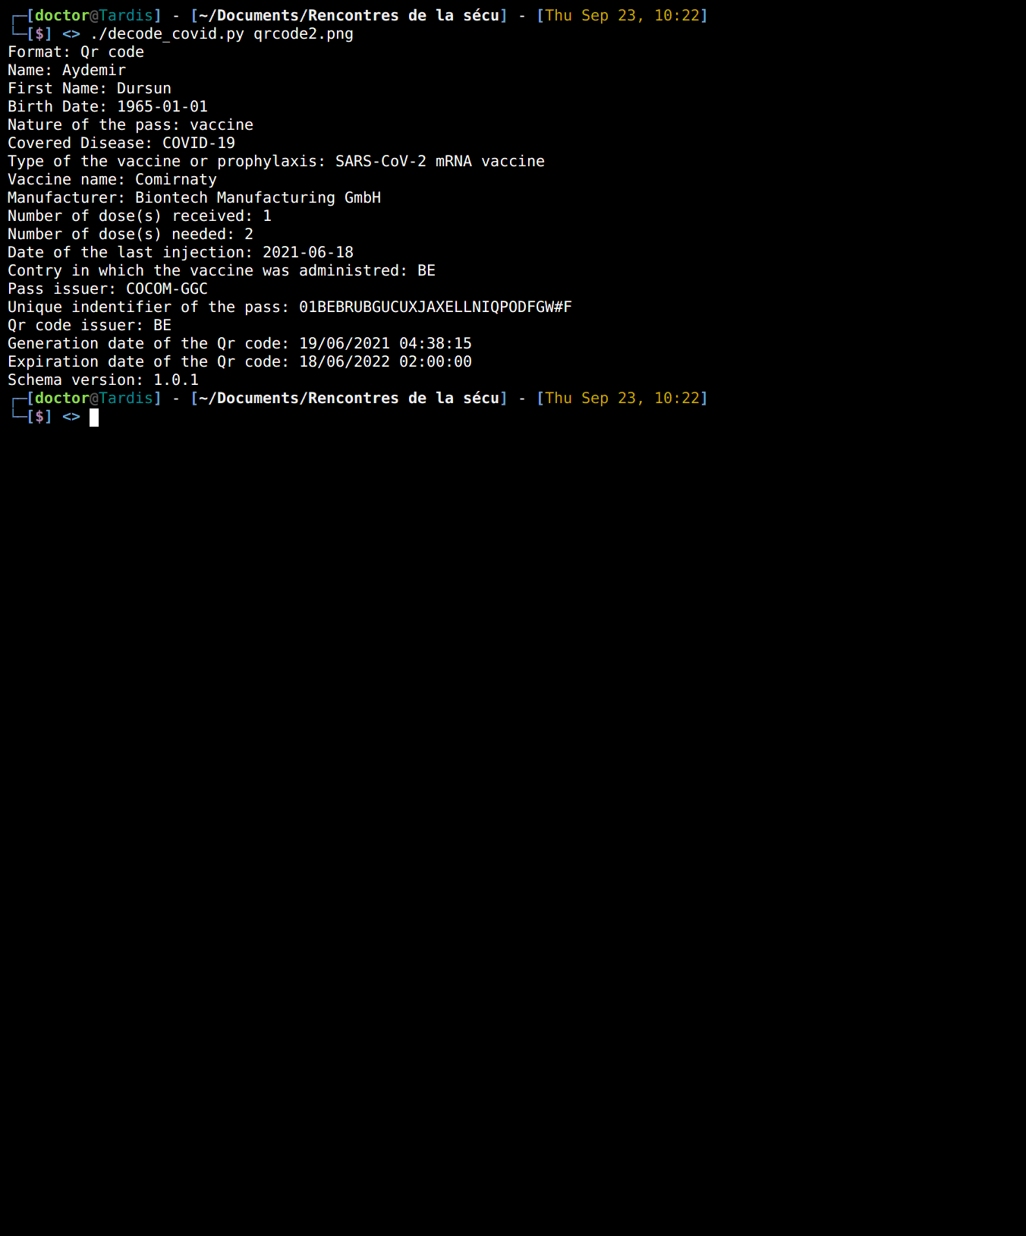
But what does it contain?
DDC QR code
Notes:
The 23rd of June 2021, Covid Certificates were uniformized between countries inside the EU. All the counties adopted the Digital Covid Certificate (DCC) based on the QR code technology.
A lot less information are made to be stored in it as described in the specifications(1).
This new certificate was made for three purposes:
- Vaccine
- Tests (PCR)
- Recoveries

Slide 20
But what does it contain?
Personal data | Medical data
Name | Name of the vaccine
First Name | Number of doses received
Date of birth | Number of doses needed
 | Date of the last injection
 | Country in which the vaccine was administered
 | The issuer of the pass (ex: CNAM)
DDC QR code
Notes:
The data is encoded using base 45 and Zlib. Once decoded, the data is represented using the CBOR format; which basically a binary JSON, contained in a COSE binary; which is an object containing headers, a payload and a signature. Even if there are many layers of encoding, the data is easily accessible and the QR codes can be decoded without needing any other external data.

Slide 21
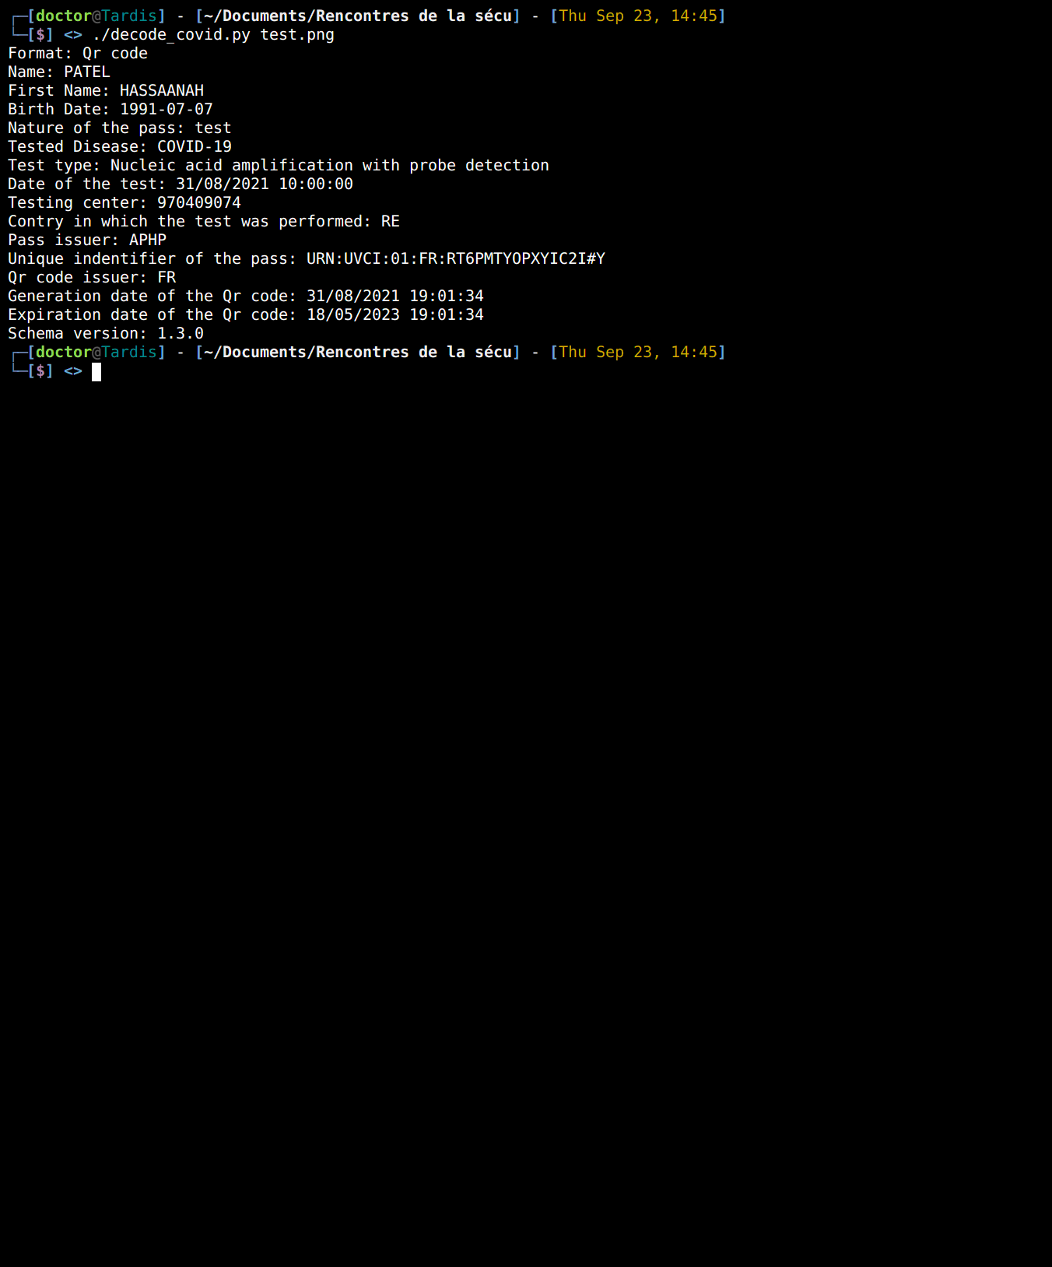
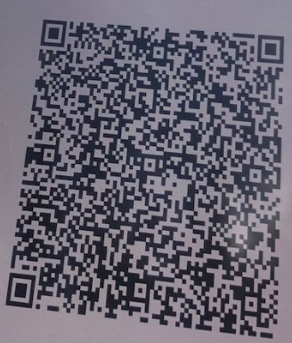
We know for the vaccine, and what about the COVID tests?
COVID Test QR code
Notes:
Fun fact: it’s much harder to find a COVID certificate for a test, even a fake one, than a valid vaccine certificate on Google image

Slide 22
But what does it contain?
Personal data | Medical data
Name | Type of test
First Name | Date and time of the test
Date of birth | Testing center
 | Country in which the test was performed
 | The issuer of the pass (ex: CNAM)
COVID Test QR code
Notes:
The data is contained in the exact same way as for the vaccine one

Slide 23
And the rest of the world?
Country | Certificate name
UK | NHS Covid Pass
Switzerland | Covid Certificate
Israel | Green Pass
China | Virus Passport
US | Federal Covid Vaccination Passports
Australia | G2G Pass
Notes:
The goal of those certificate vary depending on the country, for example, in Australia, the pass is only required for travels. All the mentioned COVID certificate are based on QR codes.

Slide 24
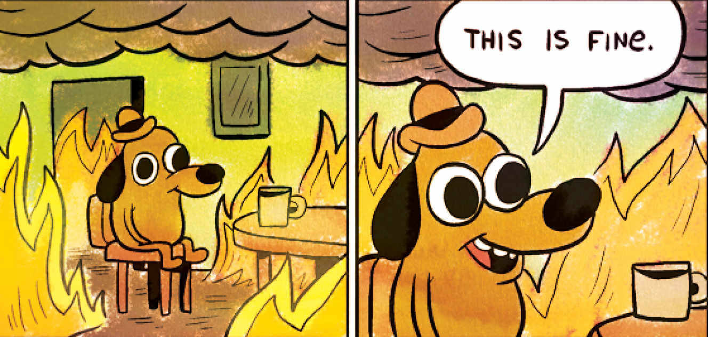
Is it possible to steal a COVID pass?
The EU covid pass contains identity information about its holder. The data contained in the QR code is digitally signed so it is impossible to modify its content without having the private certificate used to sign it.
However, most of the employees in charge of verifying the COVID passes status can’t check the identity of the pass holder. It is possible to abuse this situation to use the pass of someone else. It is important to keep in mind that this action is illegal and will result in legal pursuits(1).
LU: 3 years of prison and a 45 000 euros fine for forgery and use of forgeries. (2)
1: https://www.service-public.fr/particuliers/actualites/A15095
2: http://www.lessentiel.lu/fr/corona/story/il-achete-un-faux-pass-sanitaire-300-euros-15498048
Notes:
http://www.lessentiel.lu/fr/corona/story/il-achete-un-faux-pass-sanitaire-300-euros-15498048 source amende

Slide 25
Someone has a picture of my COVID certificate, what does it mean for me?
Since the data contained in the COVID certificates are not encrypted, a person having access to your certificate has access to all the data mentioned previously.
Most information are necessary to make the checking of the certificate doable offline, but it allows to deduce certain information: If you received the Pfizer vaccine and you only needed one dose, that means that you already had the COVID.

Slide 26
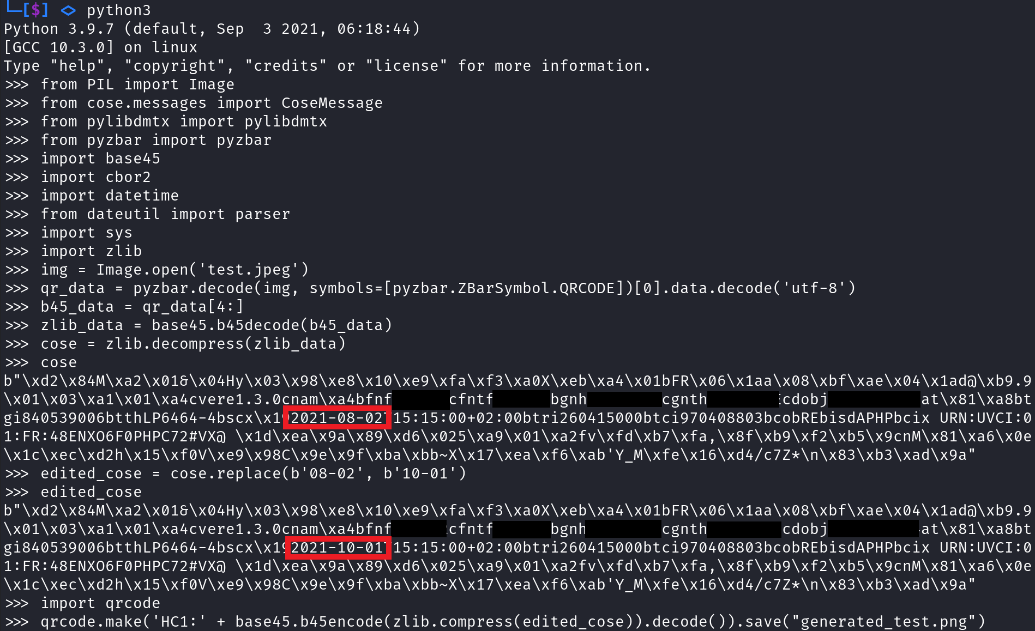
Editing a COVID certificate

Slide 27
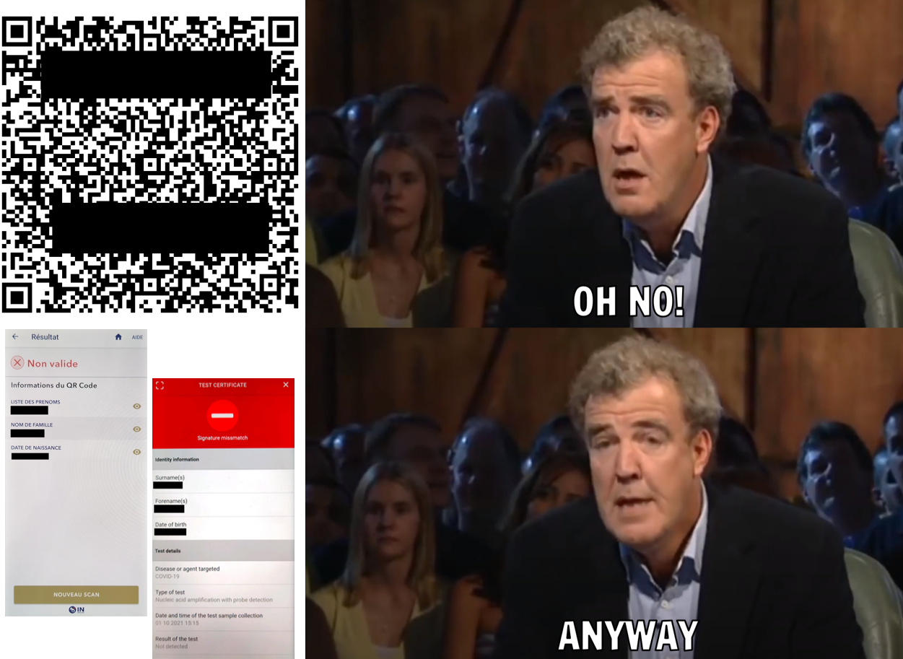
Editing a COVID certificate

Slide 28
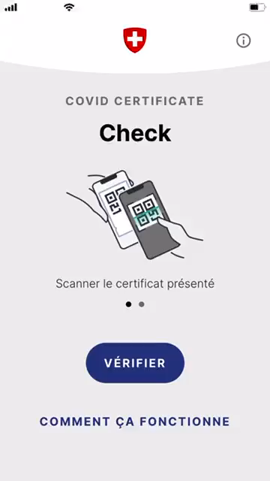
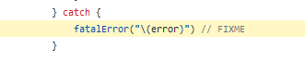
Switzerland Covid application bug (patched)
A QR code was able to defeat the Certificate check app
How?
An invalid value (too large) for a certain field caused an exception
→
No error handling ➔ Crash ➔ Application closing 📵
Combined with social engineering techniques to bypass Covid certificate check
@rooftkfm on twitter: https://twitter.com/rootkfm/status/1439676436101619712
Notes:
https://github.com/eu-digital-green-certificates/SwiftCBOR/blob/87b967bb9017303b54e0cbda659011e08821bcad/Sources/SwiftCBOR/Decoder/UnkeyedDecodingContainer.swift#L62

Slide 29
3. CONTACT TRACING APPS
How does the different protocols work ?
Which app use which protocol ?
How efficient is it ?
Are we being tracked ?
By GPS ? By the vaccine chip ? ☺
Is it truly anonymous ?
Apple/Google, custom development ? Open source or not ?
What happens if there is a breach ?
Notes:
Contact tracing app are made to follow and slow down the COVID
All app are compliant with EU lows about the data privacy.

Slide 30
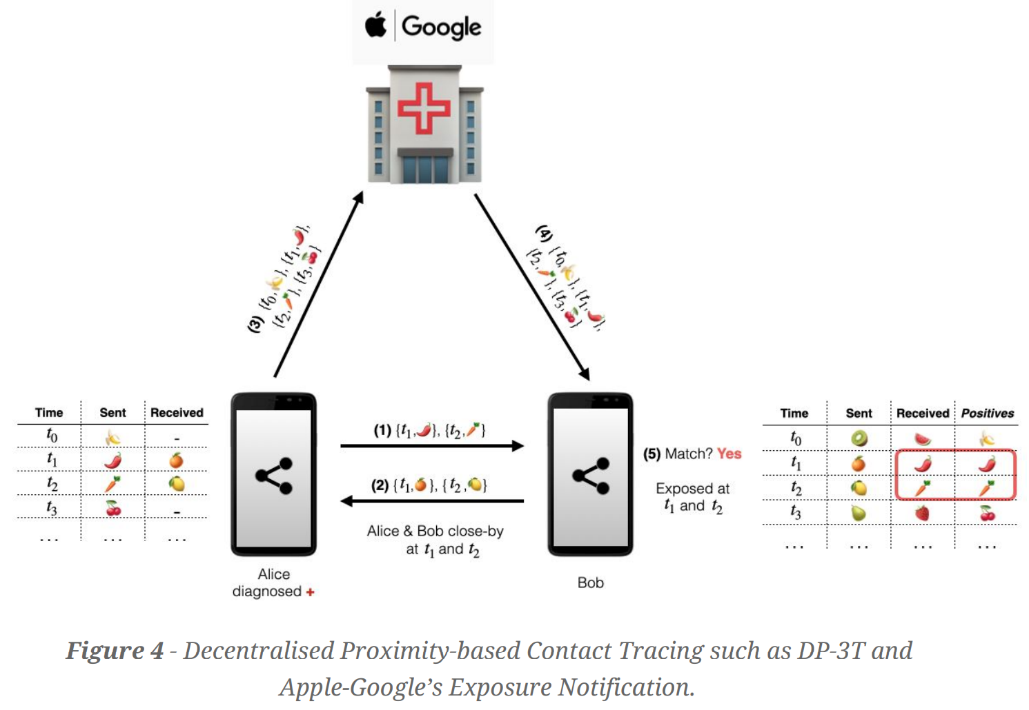
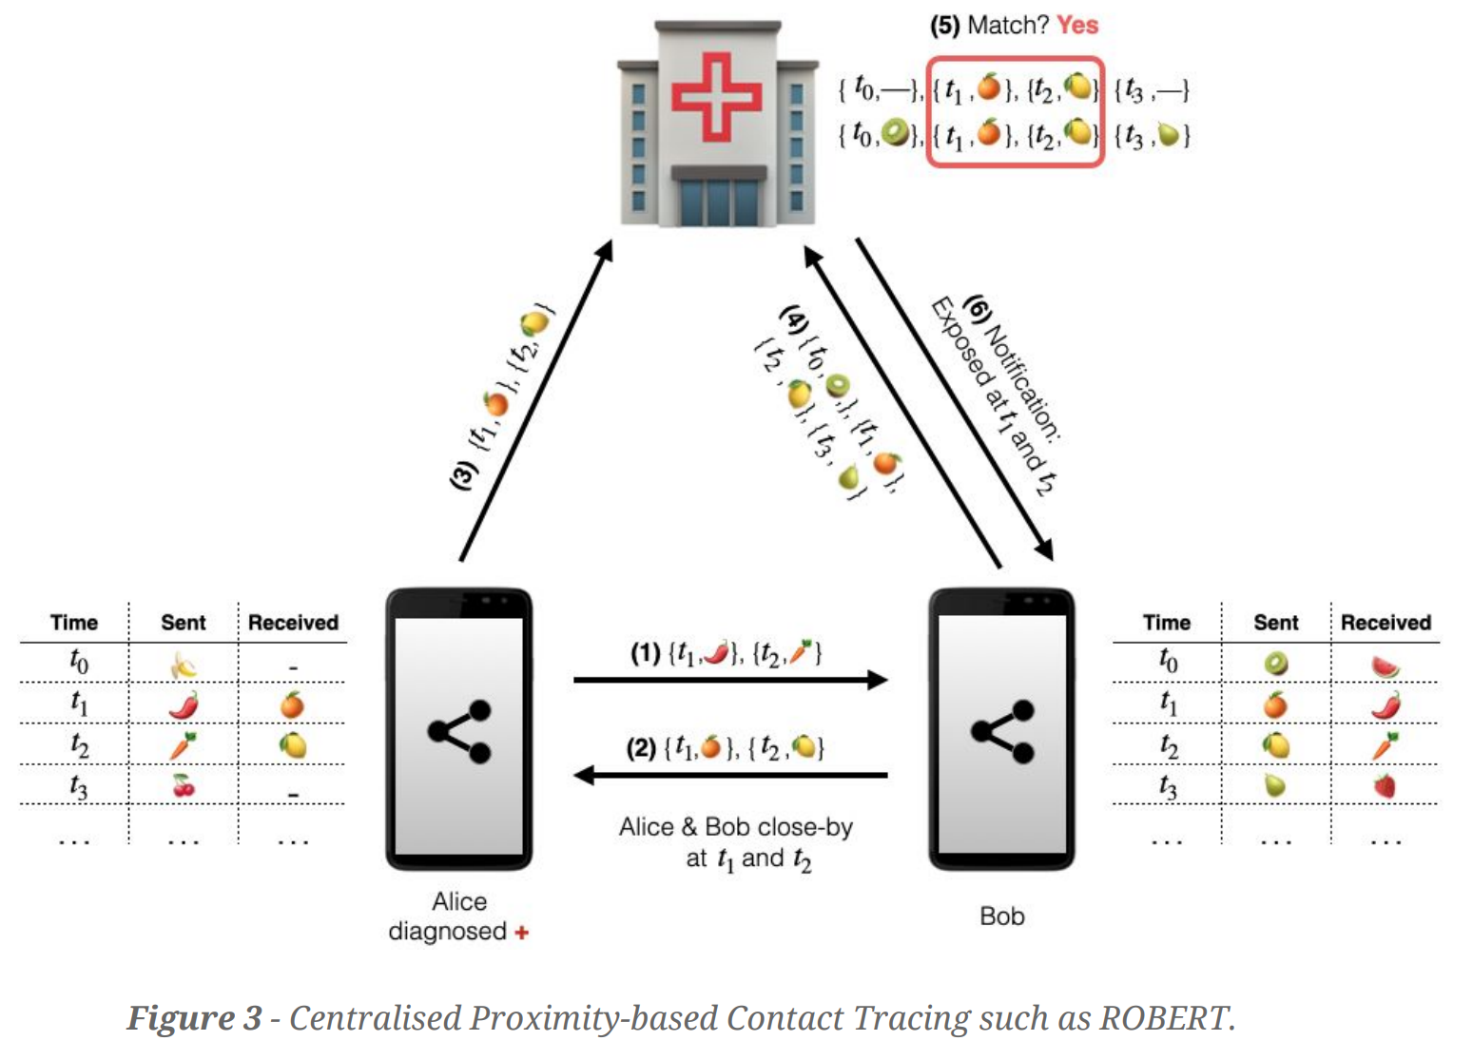
3. CONTACT TRACING APPS
→ A lot of protocols
Centralized
PEPP-PT
UK
Robert
FR
Decentralized
DP-3T
BE
DE
Exposure Notifications (Apple/Google)
BE
DE
https://arxiv.org/ftp/arxiv/papers/2007/2007.02806.pdf
Notes:
Centralised:
Server computes contacts
Only the notification is send
Decentralized:
The server send to othe users the keys of COVID+ people
The smartphone download the keys and compute if the user was in contact with a covid+ people.

Slide 31
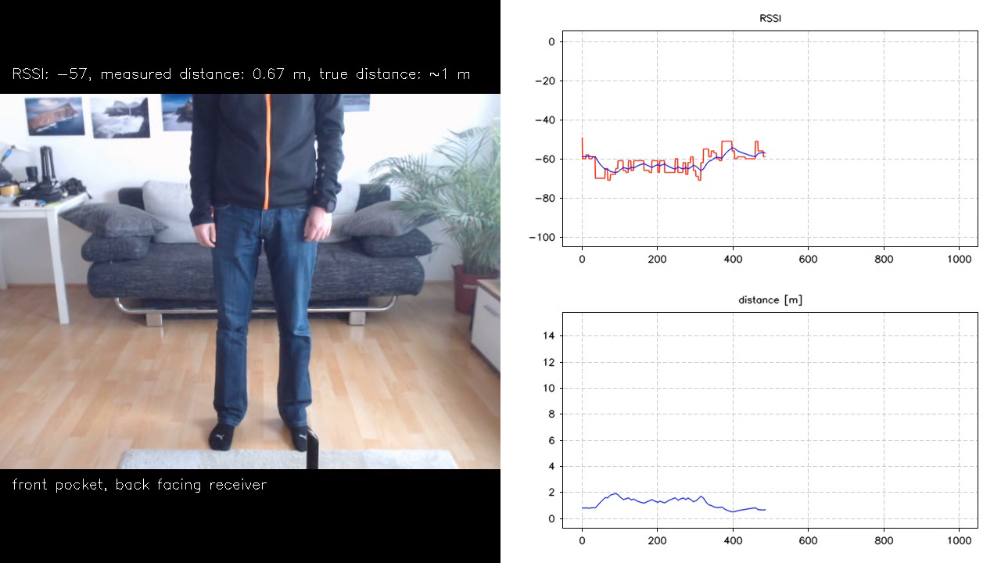
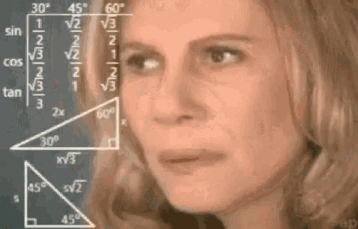
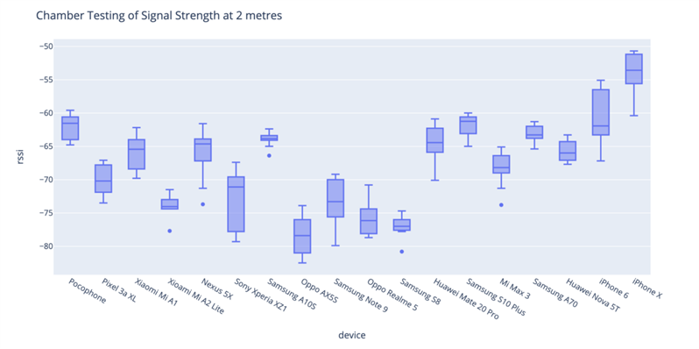
3. CONTACT TRACING APPS
→Is it helpful ? Yes or no … I mean we don’t know
Pro
Con
If I’m in contact with a Covid+ I will be alerted
Each usage is helping (even less than 60%).
the app used calibrated values for detecting contact to 1m50 and during 15min
If I’m asymptomatic, I can’t advertise others.
60% of people should use the app.
Bluetooth is not precise at all.
https://www.youtube.com/watch?v=SAi24ctpyZQ
https://www.nextinpact.com/article/30292/109007-contact-tracing-on-refait-point-sur-problemes-avec-bluetooth
Notes:
The 60% (in fact 59%) is the optimum percent of usage in order to « kill » the pendemic.
Even with less users, the usage of contact tracing will help to slow down the pandemic.

Slide 32
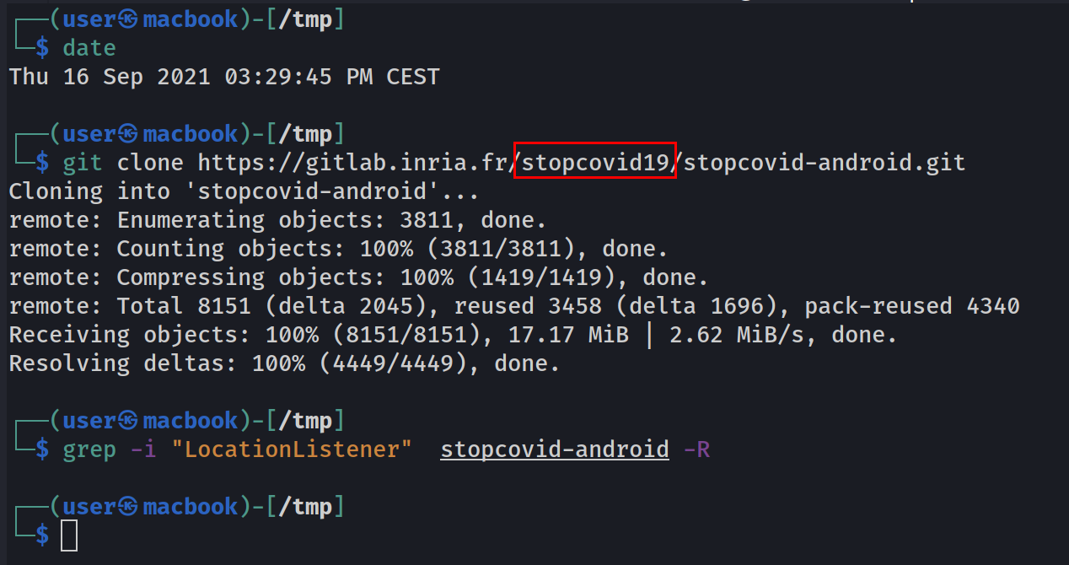
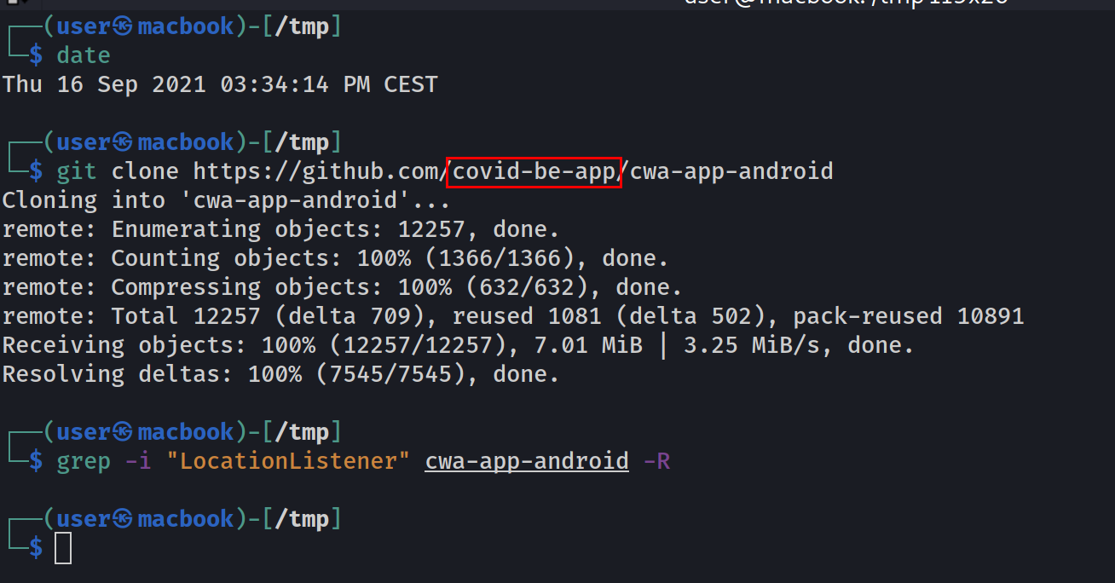


3. CONTACT TRACING APPS
→Are we being followed ?
Really hard to answer…
On Be, Fr and De application, no GPS used
Apple/Google notification Exposures … we don’t know except inside dev ☺
Close source apps …need some reverse engineering
Centralized protocol
The server have all the data, so it could be possible to make a contact graph
Decentralized protocol
With a lot of resources, it could be possible to sniff on public space all Bluetooth request.
https://github.com/oseiskar/corona-sniffer

Slide 33



3. CONTACT TRACING APPS
→What append if there is a breach ?
On client side
Bluetooth breach
Private key stolen
On server side
Server compromised
Centralized
Decentralized
Notes:
Private key: In decentralized mode, a private key is generated each day, and in case of COVID+, the key of the day 0 is send to other user. Then the other user will compute some additional key for the next day when the user is contagious and will check if he received that key. If an attacker is able to steal the first key, it could be possible to compute all the key of that user for all the days. With that information it could be possible to trace that user.

Slide 34
Takeaways
Covid applications arise quickly and are now used by a huge amount of users
Different purposes: Getting your covid certificates, Scanning valid certificates for restaurants/events or alerting in case of contact with Covid case.
They treat sensitive data and personal information of million people. Security is essential
Just like an ID card, Covid QR codes should not be shared online because they contain personal data.
There are no evidence of users tracking or exfiltration of personal data in Covid apps. The apps are typically less intrusive in term of permissions and privacy than the top 10 most used apps. (Facebook, Messenger, Instagram,…)
Their design model is overall well-though and follow good practice in term of security although improvements are always welcome.
100% security does not exist ➔ checking for vulnerabilities and applying security patches is required. Open source = more researchers are able to contribute

Slide 35
Thank you!
Q&A Session

